Slide 1
Neural Radiance Field with Refraction
Zhangkaiwen Chu

Slide 2
Training
Input of position is normalized, range from -1 to 1
Position is still small without normalization
Offset field can predict offsets like 10 or 100, totally mess up the training
Tanh activation restricts the offset in [-1, 1]
Tanh makes the training harder, offset field becomes all zeros
Conditionally regularize the offset
Use L1 regularization to create sparse offset field

Slide 3


Results
NeRF
LB-NeRF

Slide 4

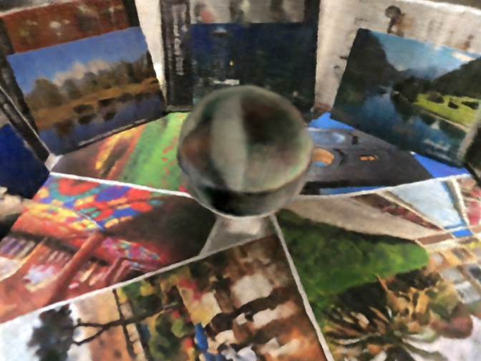


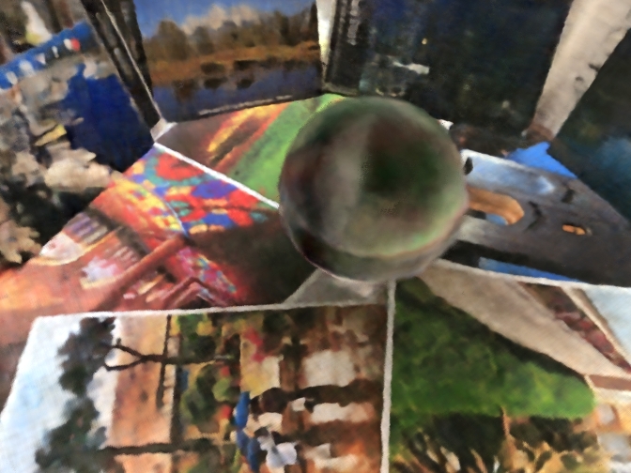

Results
reference
NeRF
LB-NeRF

Slide 5
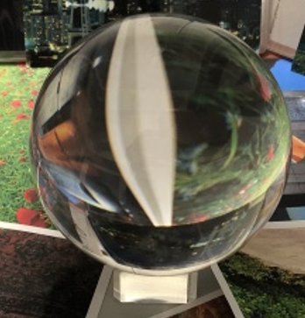
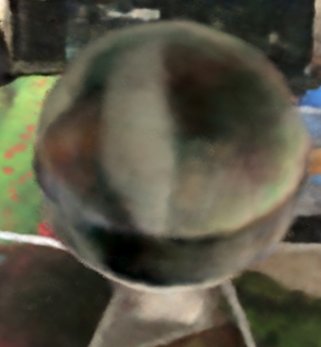
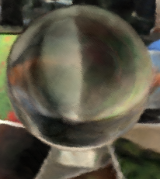
Results
reference
NeRF
LB-NeRF

